Slide 1
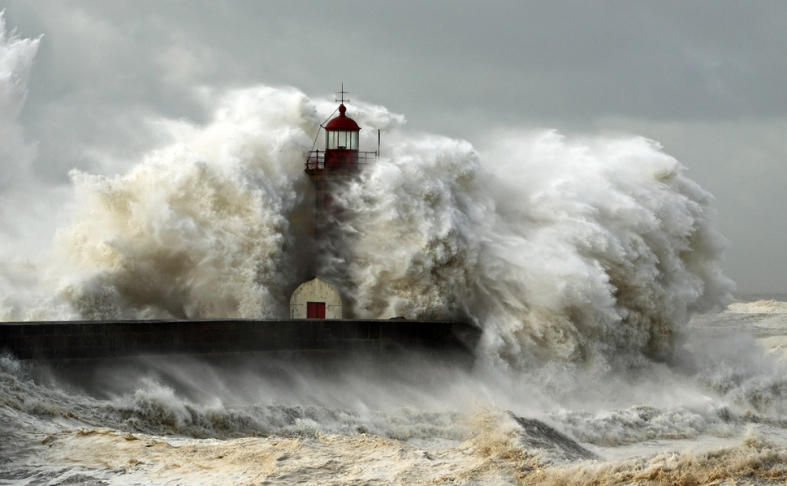
Be Steadfast
Judges
Dr. Rick Griffith • Crossroads International Church Singapore
CICFamily.com • BibleStudyDownloads.org

Slide 2
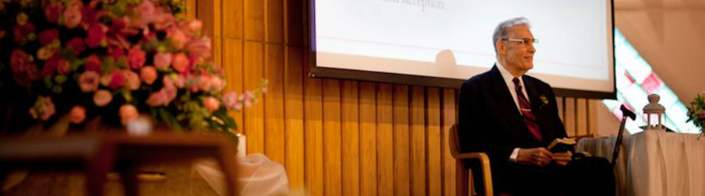
Dr E N Poulson
Arrived in Singapore 17 March 1953
Notes:
Our world tempts us to trust anything or anyone but God. Yet God provides rare examples of those who are steadfast in their faith. Dr. E. N. Poulson was such an example.
He arrived in Singapore from the USA on 17 March 1953 as a missionary to Indonesia. The plan was to apply for his visa from Singapore, then invest his life in Indonesia.

Slide 3
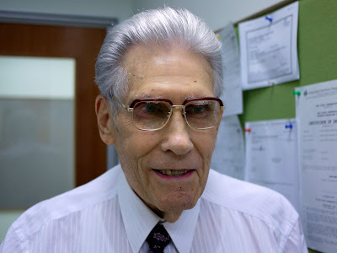
Dr E N Poulson
1 April 1925—13 October 2017
Notes:
A full 64 years later, he was still ministering in Singapore until the Lord called him home on 13 October 2017.
Dr. P, as he was affectionately known, established the School of Theology (English) at Singapore Bible College in 1958—the year I was born!

Slide 4
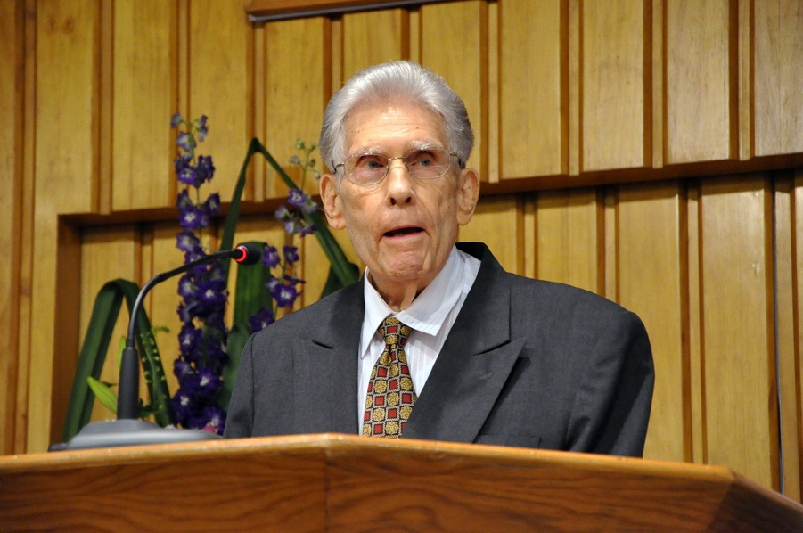
Dr E N Poulson
Notes:
He actually served for 5 years at SBC before that, ironically, teaching the Chinese how to speak Indonesian. Such is the way God works. He brought an Ang Mo to Singapore to teach them the indigenous language of the island!
Dr. P served at SBC until 1988—a full 36 years. I often told him that one of my life goals was to beat his 36 years of service to the college. That will happen if I am able to continue until I am age 70.

Slide 5
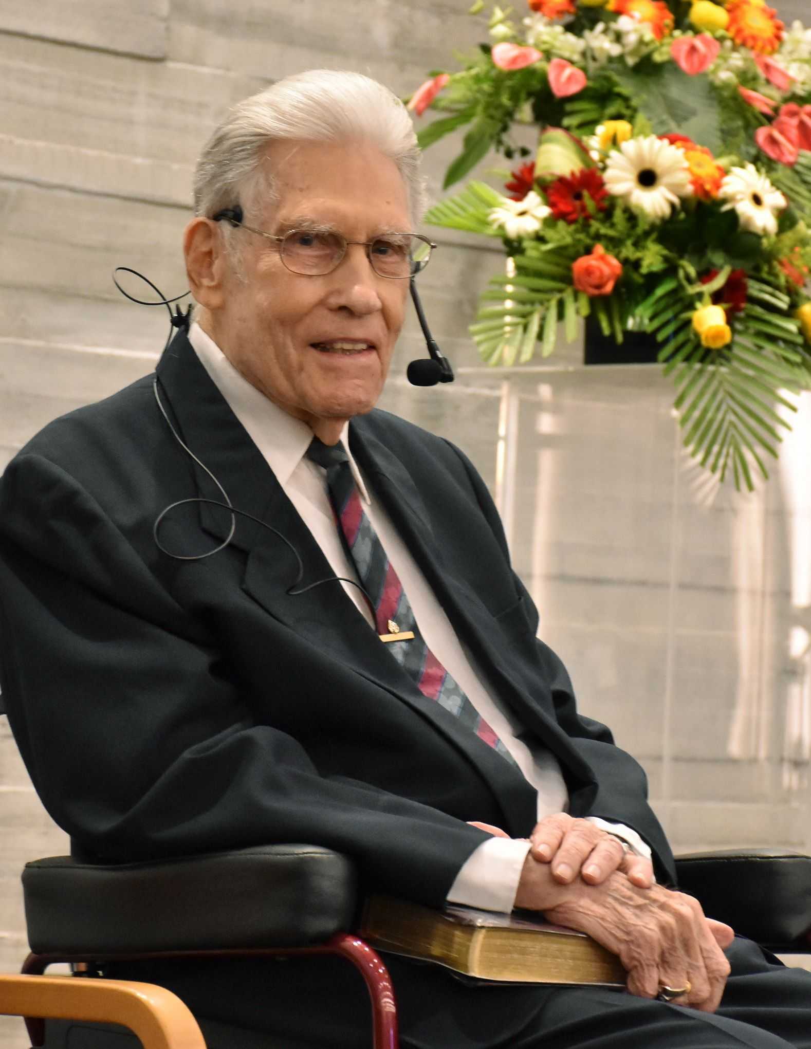
Dr E N Poulson
Notes:
He never intended to retire, so he never did. He taught a Tuesday night Bible Study to SS teachers at Grace Baptist all the way until three days before his home going.

Slide 6
Steadfast.
Notes:
Dr. P mentored me as my pastor at GBC for our first ten years in Singapore, but stayed in touch the 17 years since then. He was a model to me of one whose goal was to “be steadfast” in putting his trust in the Lord.

Slide 7
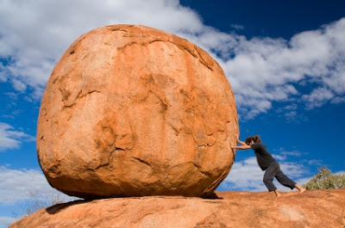
Where are you putting your trust? Do you have an immovable trust in God?
Notes:
How much money do you need to feel secure? One SBC student about 20 years ago said she was called to mission but needed to build up her bank account first. My colleague asked her how much she felt she needed in the bank before she left. With a straight face she noted, “Just 1$ million.”
Does your self worth come from your occupation, social standing, or national identity?
Do you place faith in scientists, philosophers, media personalities, or wealthy people—or in God?
Who is the real king or boss in your life that is worth your trust? I suggest that you be steadfast to trust God above all else.

Slide 8
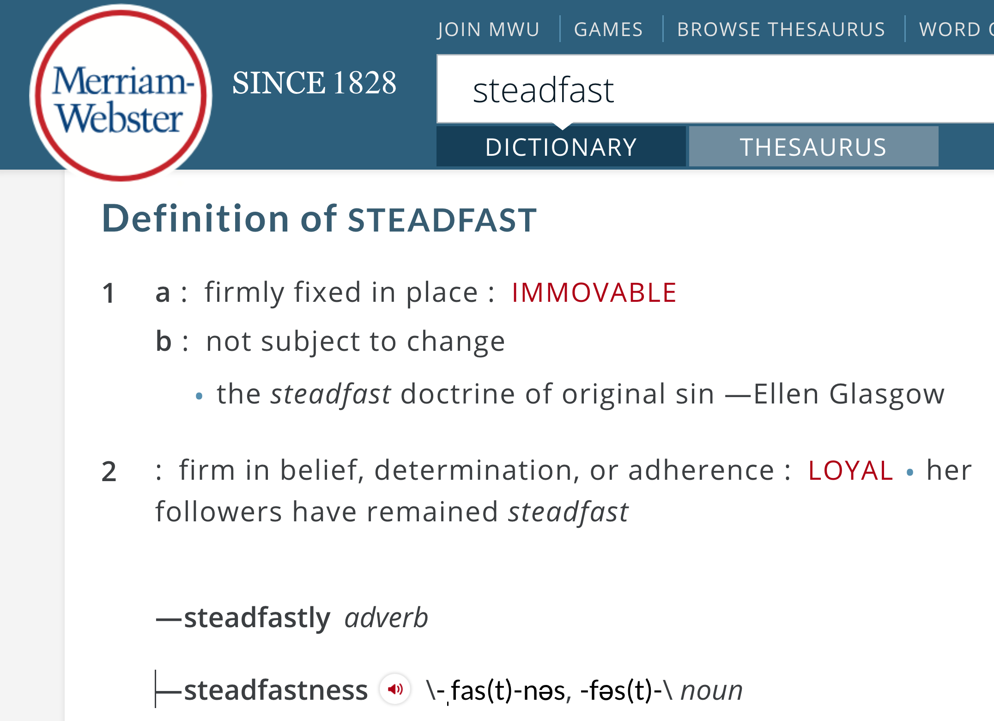
Defining "Steadfast"
1 a :firmly fixed in place :immovable
b :not subject to change the steadfast doctrine of original sin
—Ellen Glasgow
2 :firm in belief, determination, or adherence :loyal her followers have remained steadfast
Notes:
Being “steadfast” means to be immovable from your place.

Slide 9
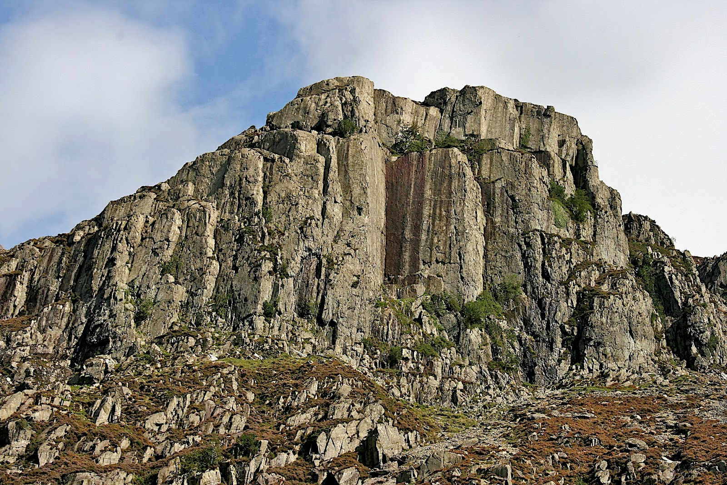
Why must you be steadfast in having God as your king?
Notes:
What is so bad about having relative standards?

Slide 10
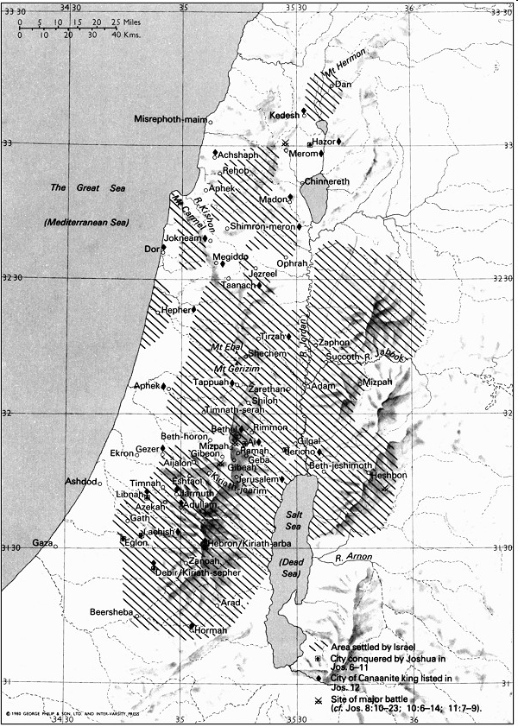
Land Settled under Joshua
181
New Bible Atlas
Notes:
The Israelites struggled to be steadfast, and today we will see why they trusted idols instead of trusting God.
Israel had completed the conquest and settled the majority of Canaan, and then Joshua died (book of Joshua).

Slide 11

Settlements v. Allotments
171
New Bible Atlas
The Conquest
and
settlement
under Joshua
Notes:
God had kept his promise to give them every place where they set their foot—yet still much of the land was still not cleared.

Slide 12

The Word Available to Them
5 Books of Moses + Joshua
Notes:
By this time in the OT story, they have two written sources of God’s will—the Books of Moses and the Book of Joshua. Now, what would they do with them?

Slide 13

48 Levitical Cities
171a
6 Cities of Refuge
Notes:
The Levites were spread throughout the land to provide teachers close to each of the tribes—now would they teach the people the truth of God’s Word?

Slide 14
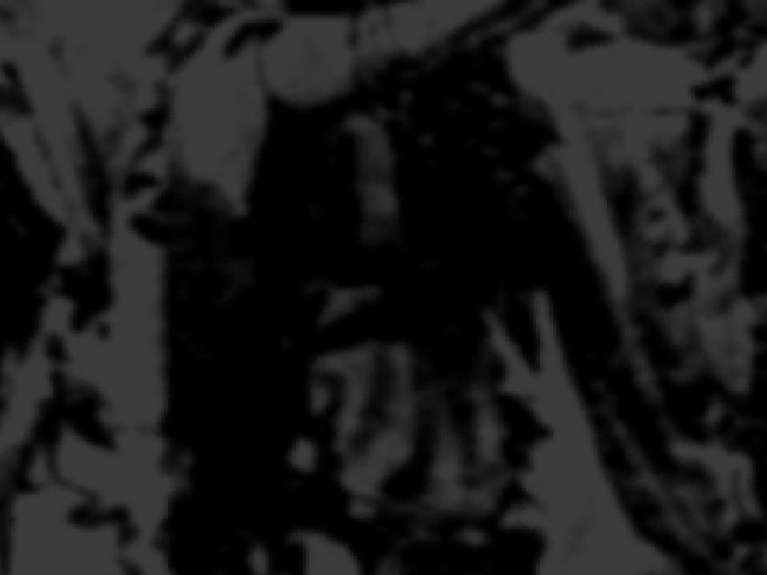
Book Chart
172
Failure Under the Theocracy
Incomplete
Occupation
Need
for Monarchy
Deliverance by Judges
1:1–2:5
2:6–16:31
17–21
Deterioration
Discipline
Depravity
Causes
Of the Cycles
Curse
Of the Cycles
Conditions
Of the Cycles
Living with
the Canaanites
War with
the Canaanites
Living Like
the Canaanites
Canaan
c. 341 Years (1390-1049 BC)

Slide 15
Why must you be steadfast in having God as your king?
3 reasons
Notes:
Today we will see three reasons to place God as king.

Slide 16
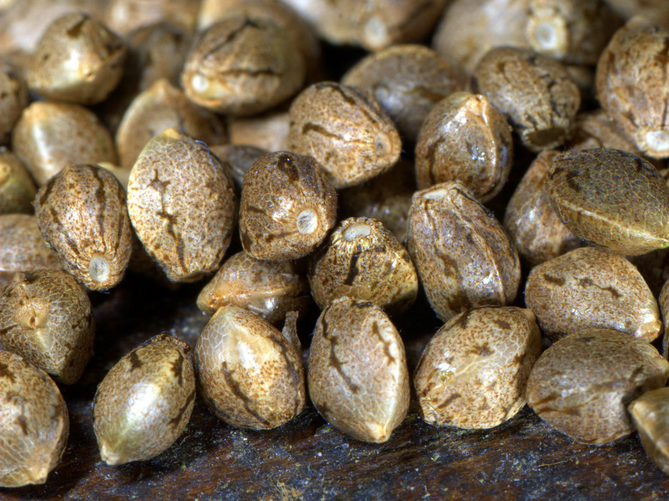
I. Incomplete obedience plants the seeds for failure (1–2).
Notes:
Rejecting God’s lordship through disobeying him as king leads to trouble.

Slide 17
Israel's incomplete occupation of Canaan led to the need for judges (1:1–2:5).

Slide 18
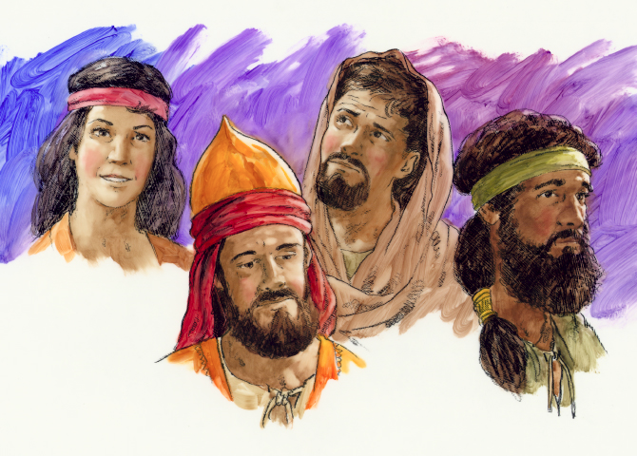
Judges
Dr. Rick Griffith, Singapore Bible College
BibleStudyDownloads.org

Slide 19
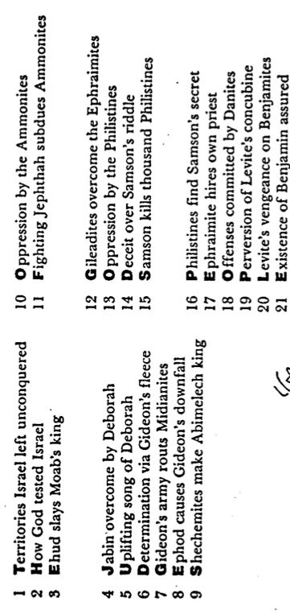
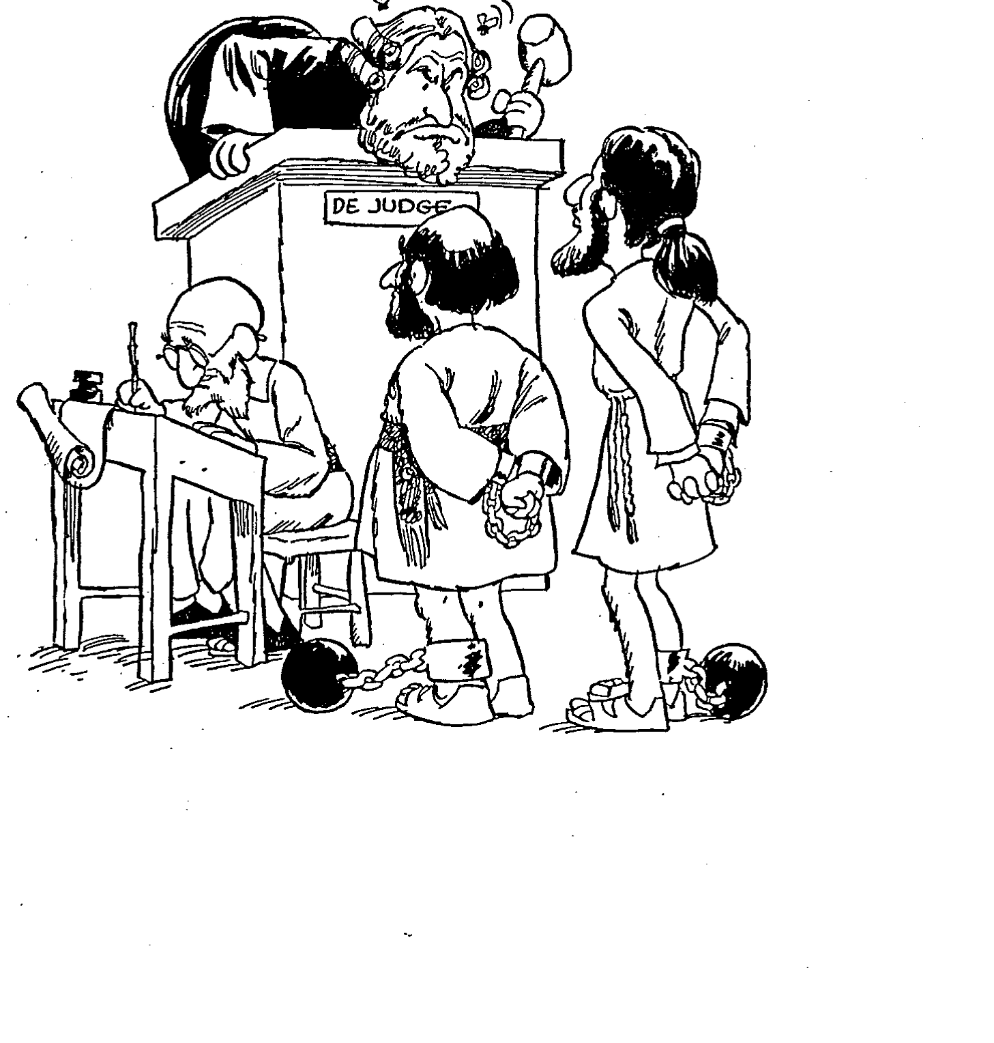
Barry Huddleston, The Acrostic Summarized Bible (Grand Rapids: Baker, 1992)
1 Inception of the world
2 Newlyweds placed in Eden
3 Temptation and man's fall
4 Hatred and first murder
5 Entire genealogy of Adam
6 Lessons on proper priorities
7 Outline for personal relationships
8 Faith of the centurion
Judges
29 Genealogy of Jesus Christ
30 Opposition of King Herod
31 Spirit's descent upon Jesus
32 Power over Satan's temptations
33 Expounding Sermon on Mount
34 Lessons on proper priorities
35 Outline for personal relationships
36 Faith of the centurion
9 Matthew's call from Jesus
10 Apostles sent to preach
11 Testimony about John's message
12 True Messiah called demonic
13 Hidden message of parables
14 Execution of the Baptist
15 Wisdom is answering Pharisees
37 Matthew's call from Jesus
38 Apostles sent to preach
39 Testimony about John's message
40 True Messiah called demonic
41 Hidden message of parables
42 Execution of the Baptist
43 Wisdom is answering Pharisees
16 Keys of the kingdom
17 Impact of Jesus' transfiguration
18 Need for true forgiveness
19 Grounds for divorce clarified
20 Opportunities in the vineyard
21 Fig tree is cursed
44 Keys of the kingdom
45 Impact of Jesus' transfiguration
46 Need for true forgiveness
47 Grounds for divorce clarified
48 Opportunities in the vineyard
49 Fig tree is cursed
22 Taxes paid to Caesar
23 Hypocrisy denounced by "woes"
24 Events of second coming
25 Judgment of the nations
26 Events on Calvary's eve
27 Way of the cross
28 Savior's resurrection and commission
50 Taxes paid to Caesar
51 Hypocrisy denounced by "woes"
52 Events of second coming
53 Judgment of the nations
54 Events on Calvary's eve
55 Way of the cross
56 Savior's resurrection and commission

Slide 20
Slides on
Judges 1

Slide 21

Populations by Tribe
171
Asher
53,400
Naphtali
45,400
Numbers 26
Joshua 13:1–19:48
Zebulun
60,500
Manasseh
Issachar
64,300
Manasseh
52,700
Levi
23,000
Spread Throughout Israel
Gad
40,500
Ephraim
32,500
Dan
64,400
Benjamin
45,600
Reuben
43,730
Judah
76,500
Simeon
22,200

Slide 22
Grades for the Tribes of Israel
171
Asher
F
Naphtali
D
Judges 1:1-35
Zebulun
D
Manasseh
Issachar
D
Manasseh
Levites
Spread Throughout Israel
Gad
F
A
Ephraim
Dan
F
F
Benjamin
Reuben
Judah
F
F
A
Simeon
A

Slide 23
Key Word
172
39
Failure
Judges

Slide 24
Theme
172
Failure Under
the Theocracy
Judges

Slide 25
Key Verse
172
"In those days Israel had no king;
everyone did as he saw fit
(what was right in his own eyes)"
(17:6; 21:25)
Judges

Slide 26
Slides on
Judges 2

Slide 27
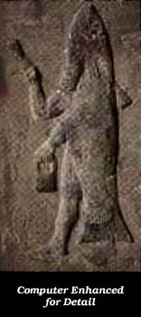
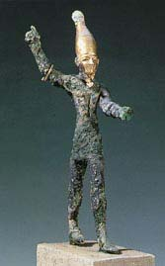
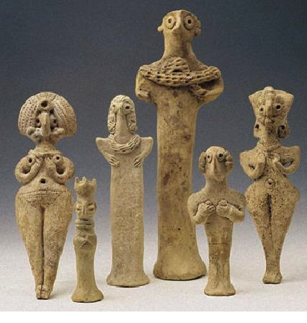
False Gods of the Land
A
S
T
H
A
R
O
T
H
DAGON
BAAL

Slide 28
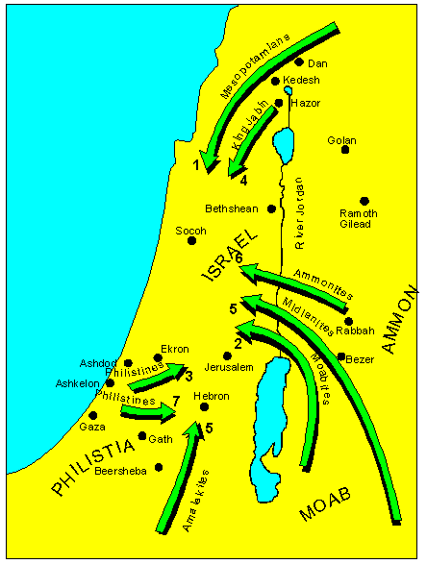
The Consequence of Breaking the Mosaic Covenant
Israel was surrounded by enemies that the Lord raised up against them.
+Taken from Nelsons 3D-M Jenkins, S. 1997, c1985. Nelson's 3-D Bible map book (electronic ed.). Thomas Nelson: Nashville

Slide 29
Disobeying the LORD as king leads to trouble.
Notes:
Incomplete obedience shows that we trust something other than God.
God then seeks to earn our trust by allowing difficulty in our lives.

Slide 30

Relativism

Slide 31
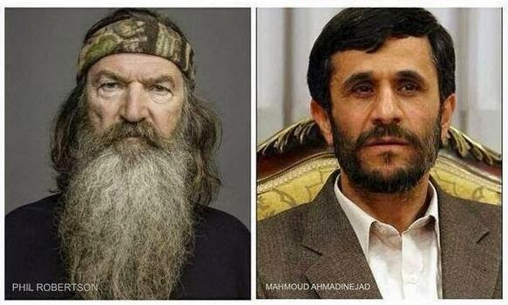
Relativism
SAYS GAYS NEED TO ACCEPT JESUS CHRIST TO GET TO HEAVEN
ORDERS GAYS HANGED, BEHEADED, STONED & BURNED ALIVE
LIBERALS DEMAND HE BE CENSORED
INVITED TO SPEAK AT COLUMBIA UNIV., USA

Slide 32
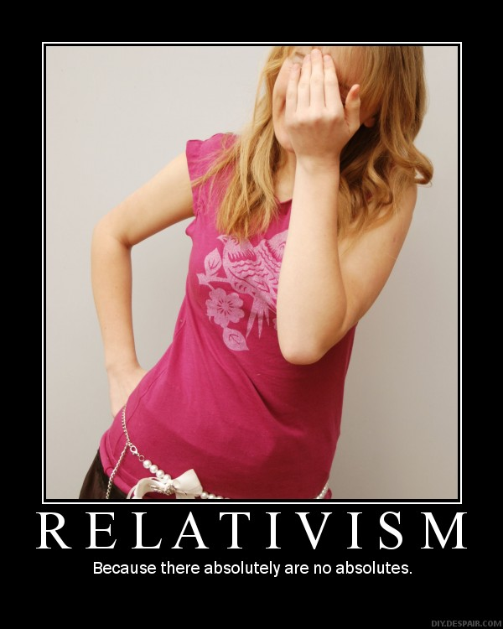
RELATIVISM
Because there absolutely are no absolutes.

Slide 33
Why must you be steadfast in having God as your king?
3 reasons
Notes:
Today we will see three reasons to place God as king.

Slide 34
I. Incomplete obedience plants the seeds for failure (1–2).
Notes:
Rejecting God’s lordship through disobeying him as king leads to trouble.

Slide 35

II. Relativism leads to cycles of sin (3–16).
Notes:
We go in circles when we follow our rules instead of God’s absolute standards.

Slide 36
Judges tried to stop Israel’s cycles of sin to show that God’s absolute standards were better than Israel’s relative standards (2:6–16:31).

Slide 37

The Cycle Repeated in Judges
174
1 Sin
2 Servitude
5 Silence
3 Supplication
4 Salvation
Notes:
The introduction previews God's repeated provision of judges even though Israel broke the covenant after Joshua’s death (2:6–3:6).

Slide 38
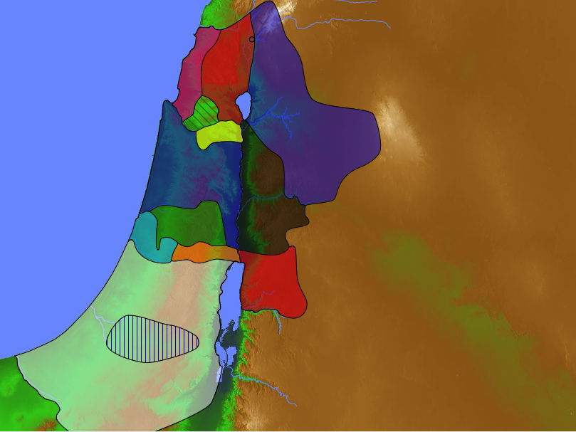
Where were the judges from?
Naphtali
180a
Asher
Shamgar
Zebulun
Elon
Barak
Manasseh
Issachar
Gideon
Jair
Tola
Manasseh
Abdon
Jephthah
Abimelech
Gad
Deborah
Ephraim
Dan
Ehud
Benjamin
Samson
Reuben
Izban
Judah
Othniel
Simeon

Slide 39
Slides on
Judges 3

Slide 40
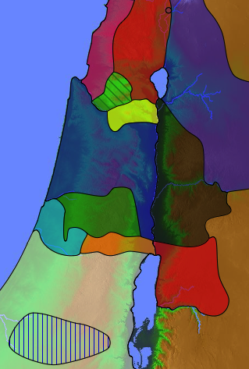
Enemies in Canaan During the Judges (3:5)
Sidonians
Mesopo
tamians
181
Phoenicians
Amorites
Canaanites
A m o r i t e s
Ammonites
Perizzites
Hivites
Jebusites
Philistines
Moabites
Amalekites
Edomites

Slide 41
Where did Othniel judge (3:7-11)?
Naphtali
Cushan-Rishathaim
180a
Asher
Zebulun
Manasseh
Issachar
All
Israel
Manasseh
Gad
Ephraim
Dan
Benjamin
Reuben
Judah
Othniel
Simeon

Slide 42
Where did Ehud judge (3:12-30)?
Naphtali
180a
Asher
Zebulun
Manasseh
Issachar
Manasseh
Gad
Ehud
Ephraim
Dan
Benjamin
Reuben
Judah
Simeon
Moab

Slide 43
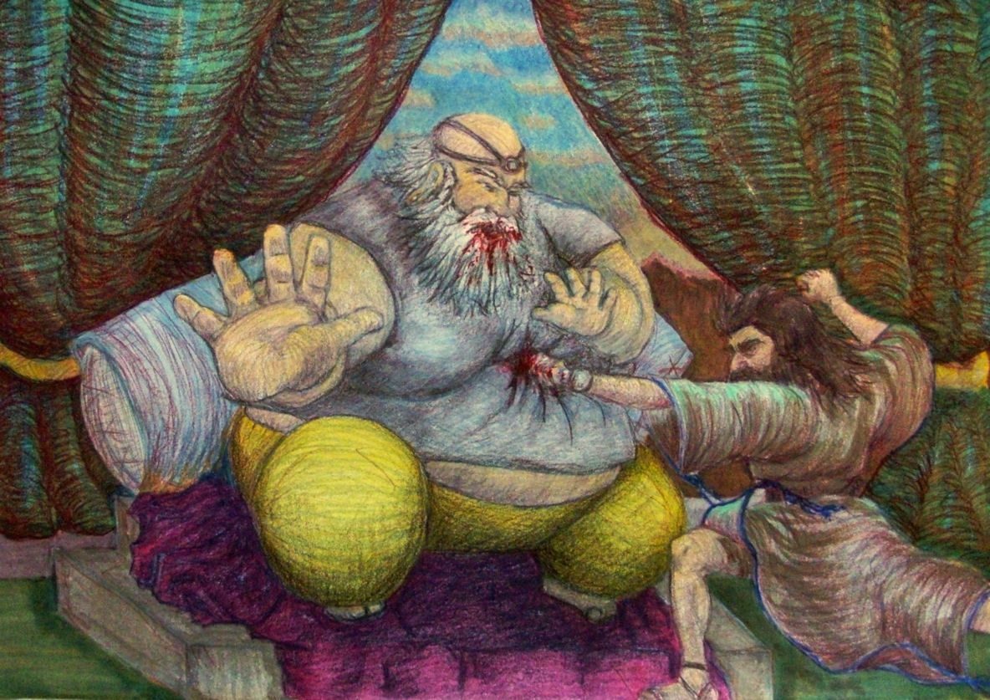
Ehud

Slide 44
Where did Shamgar judge (3:30)?
Naphtali
180a
Asher
Shamgar
"After Ehud, Shamgar son of Anath rescued Israel. He once killed 600 Philistines with an ox goad"
(3:31 NLT).
Zebulun
Manasseh
Issachar
Manasseh
Gad
Ephraim
Dan
Benjamin
Reuben
Judah
Philistines
Simeon

Slide 45
Slides on
Judges 4

Slide 46
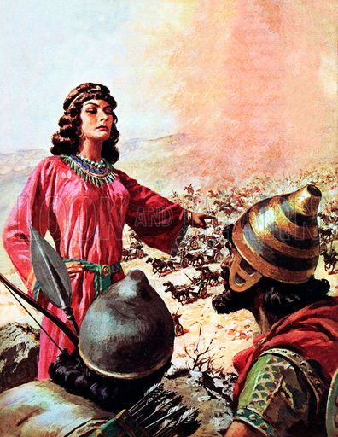
Deborah & Barak

Slide 47
Where did Deborah & Barak judge?
Naphtali
180a
Asher
Zebulun
Manasseh
Barak
Issachar
Manasseh
Gad
Ephraim
Deborah
Dan
Benjamin
Reuben
Judah
Simeon

Slide 48
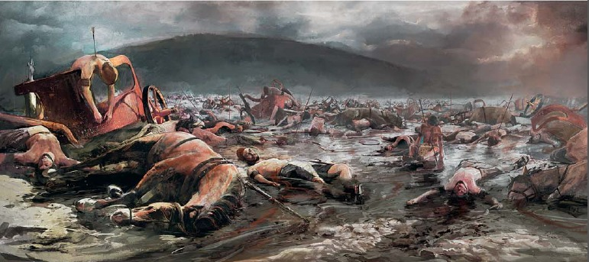
10,000 Israelite men defeated 900 Canaanite chariots (Judges 4:3, 6)

Slide 49
Slides on
Judges 5

Slide 50
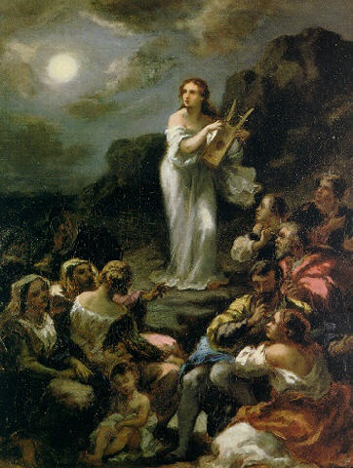
Deborah's Song (Judges 5)

Slide 51
Slides on
Judges 6

Slide 52
Where did Gideon judge?
Naphtali
180a
Asher
Zebulun
Manasseh
Issachar
Gideon
Manasseh
Gad
Ephraim
Dan
Benjamin
Reuben
Judah
Simeon

Slide 53
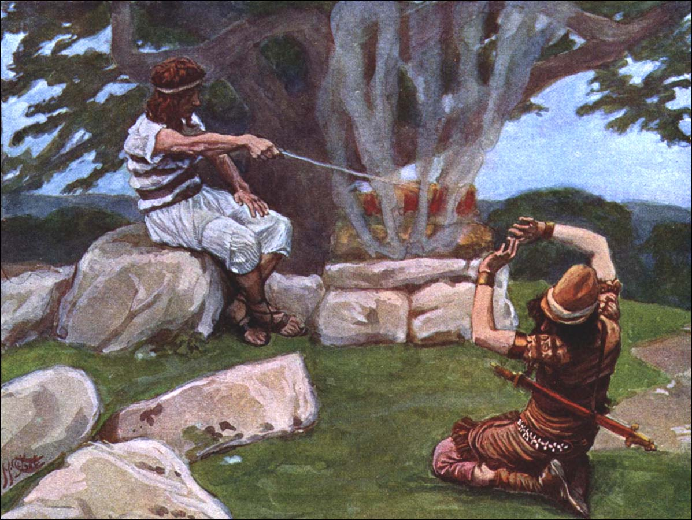
God Called Gideon

Slide 54
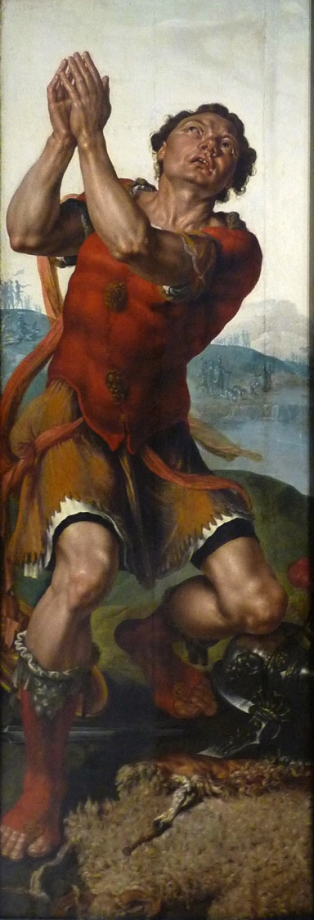
"Gideon thanks God for the miracle of the dew"
Painting by Maarten van Heemskerck (Musée des Beaux-Arts de Strasbourg) in AD 1550

Slide 55
Slides on
Judges 7

Slide 56
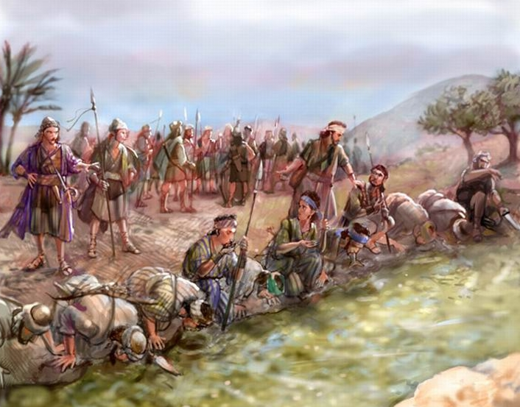
Gideon Trimmed Down His Troops (7:1-8a)

Slide 57
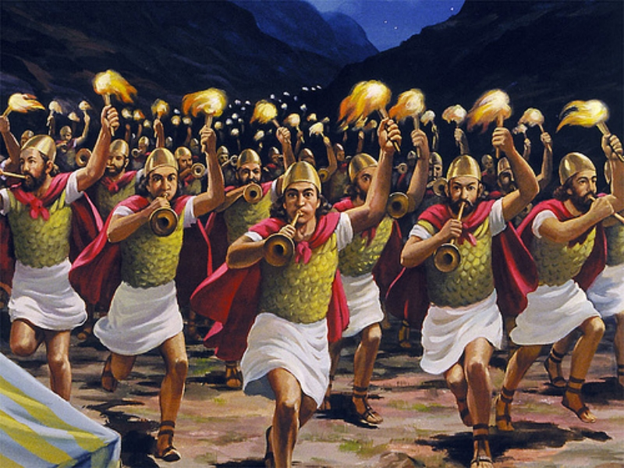
Gideon Defeated the Midianites (7:17-21)

Slide 58
Slides on
Judges 8

Slide 59
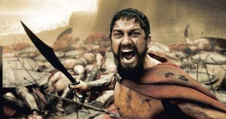
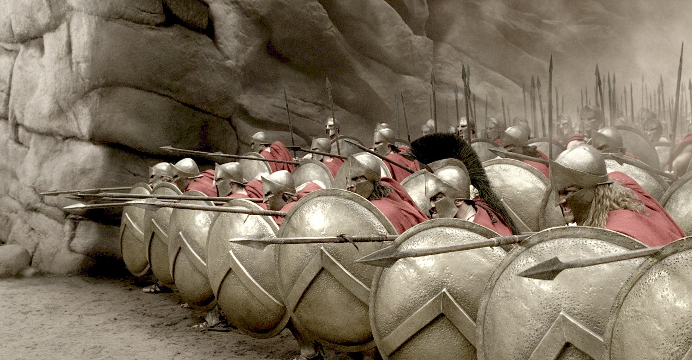
"You will break the oppressor's rod, just as you did when you destroyed the army of Midian"
(Isa. 9:4b NLT)
Gideon

Slide 60
Slides on
Judges 9

Slide 61
Where did Abimelech judge?
Naphtali
180a
Asher
Zebulun
Manasseh
Issachar
Manasseh
Abimelech
Gad
Ephraim
Dan
Benjamin
Reuben
Judah
Simeon

Slide 62
Where did Tola judge?
Naphtali
180a
Asher
Zebulun
Manasseh
Issachar
Manasseh
Tola
Gad
Ephraim
Dan
Benjamin
Reuben
Judah
Simeon

Slide 63
Slides on
Judges 10

Slide 64
Where did Jair judge?
Naphtali
180a
Asher
Zebulun
Manasseh
Issachar
Jair
Manasseh
Gad
Ephraim
Dan
Benjamin
Reuben
Judah
Simeon

Slide 65
Where did Jephthah judge?
Naphtali
180a
Asher
Zebulun
Manasseh
Issachar
Manasseh
Gad
Jephthah
Ephraim
Dan
Ammonites
Benjamin
Reuben
Judah
Simeon

Slide 66
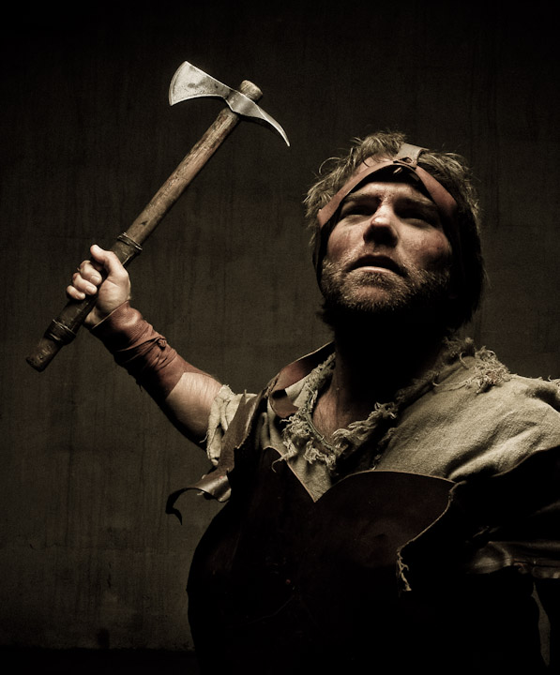
Jepththah's Victory (10:17–12:6)

Slide 67
Slides on
Judges 11

Slide 68
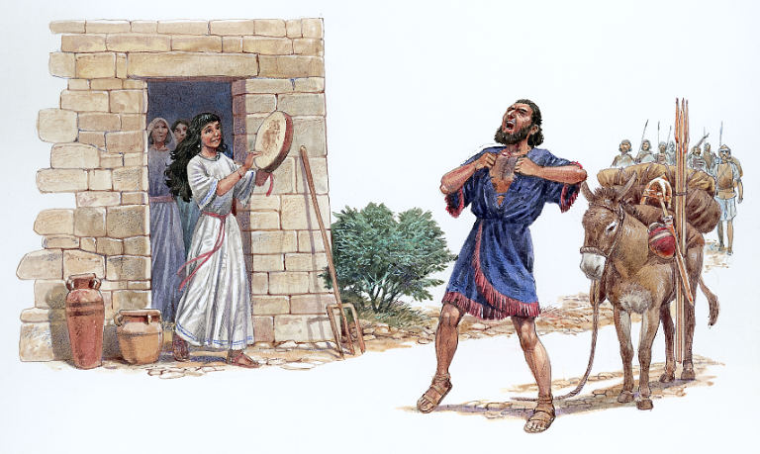
Jepththah's Daughter Greets Him (11:34)

Slide 69
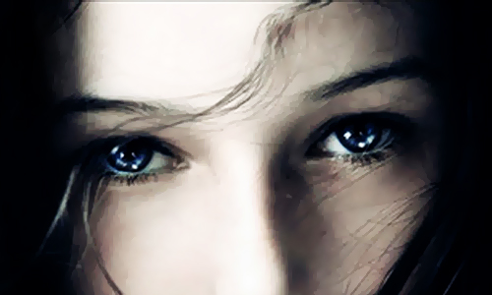
Did Jephthah really kill his daughter?

Slide 70
Slides on
Judges 12

Slide 71
Where did Izban judge?
Naphtali
180a
Asher
Zebulun
Manasseh
Issachar
Manasseh
Gad
Ephraim
Dan
Benjamin
Izban
Reuben
Judah
Simeon

Slide 72
Where did Elon judge?
Naphtali
171
Asher
Zebulun
Manasseh
Elon
Issachar
Manasseh
Gad
Ephraim
Dan
Benjamin
Reuben
Judah
Simeon

Slide 73
Where did Abdon judge?
Naphtali
180a
Asher
Zebulun
Manasseh
Issachar
Manasseh
Abdon
Gad
Ephraim
Dan
Benjamin
Reuben
Judah
Simeon

Slide 74
Slides on
Judges 13

Slide 75
The Samson Cycle
174
1 Sin
"Again the Israelites did evil in the LORD's sight…" (13:1a).

Slide 76
The Samson Cycle
174
1 Sin
2 Servitude
"…so the LORD handed them over to the Philistines, who oppressed them for forty years" (13:1b).

Slide 77
The Samson Cycle
174
1 Sin
2 Servitude
3 Supplication
Supplication Absent: No mention is made of the nation crying out to the LORD for deliverance from its enemy.

Slide 78
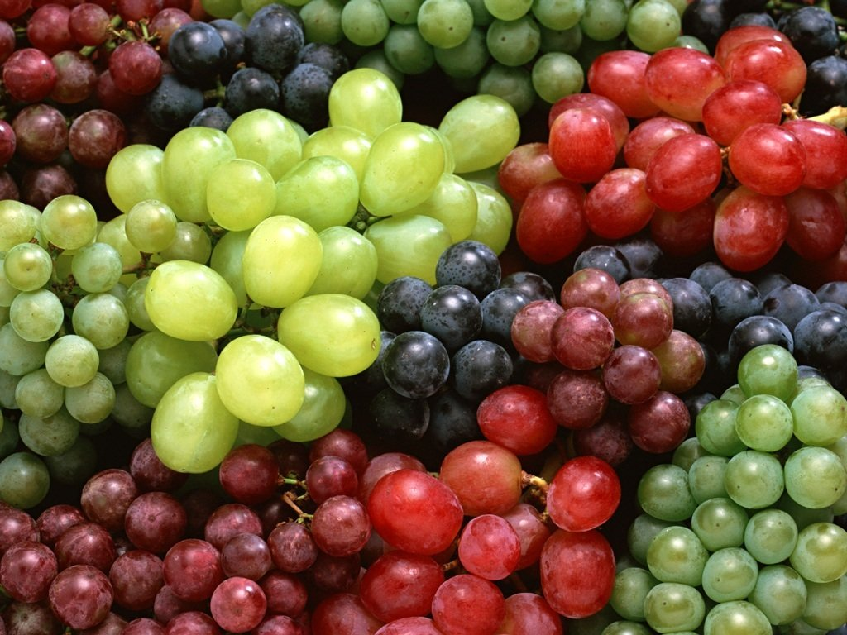
"Then the LORD said to Moses, 'Give the following instructions to the people of Israel.
²"If any of the people, either men or women, take the special vow of a Nazirite, setting themselves apart to the Lord in a special way, ³they must give up wine and other alcoholic drinks. They must not use vinegar made from wine or from other alcoholic drinks, they must not drink fresh grape juice, and they must not eat grapes or raisins"'"
(Num 6:1-3 NLT).

Slide 79

"As long as they are bound by their Nazirite vow, they are not allowed to eat or drink anything that comes from a grapevine—not even the grape seeds or skins"
(Num 6:4 NLT).

Slide 80
"They must never cut their hair throughout the time of their vow, for they are holy and set apart to the LORD. Until the time of their vow has been fulfilled, they must let their hair grow long. ⁶And they must not go near a dead body during the entire period of their vow to the LORD'"
(Num 6:5-6 NLT).

Slide 81
The Samson Cycle
174
1 Sin
2 Servitude
Samson delivers southwestern Israel from the Philistines as God's merciful provision for the nation (13:2–16:31).
3 Supplication
4 Salvation

Slide 82
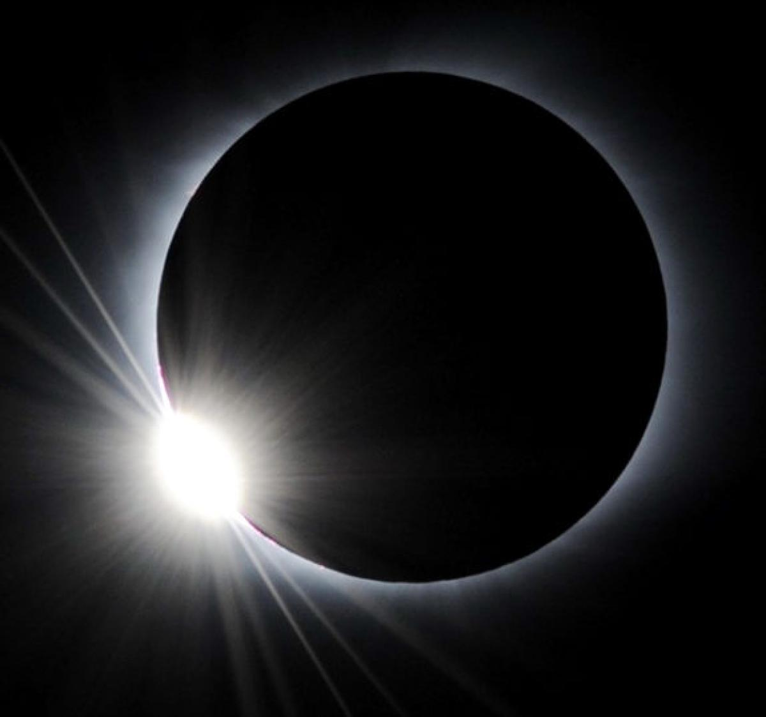
Samson: A "Sun" in Darkness
"Samson" means "Sun"

Slide 83
Where did Samson judge?
Naphtali
180a
Asher
Zebulun
Manasseh
Issachar
Manasseh
Gad
Ephraim
Dan
Samson
Benjamin
Reuben
Judah
Simeon

Slide 84
Slides on
Judges 14

Slide 85

"One day when Samson was in Timnah, one of the Philistine women caught his eye. ²When he returned home, he told his father and mother, 'A young Philistine woman in Timnah caught my eye.
I want to marry her. Get her for me'"
(Judges 14:1-2 NLT).

Slide 86
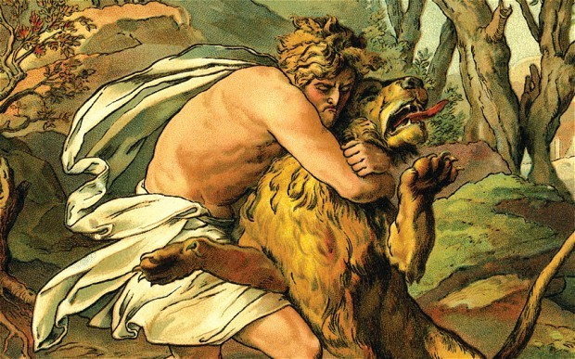
"As Samson and his parents were going down to Timnah, a young lion suddenly attacked Samson near the vineyards of Timnah. ⁶At that moment the Spirit of the LORD came powerfully upon him, and he ripped the lion's jaws apart with his bare hands. He did it as easily as if it were a young goat. But he didn't tell his father or mother about it"
(Judges 14:5-6 NLT).

Slide 87
Slides on
Judges 15

Slide 88
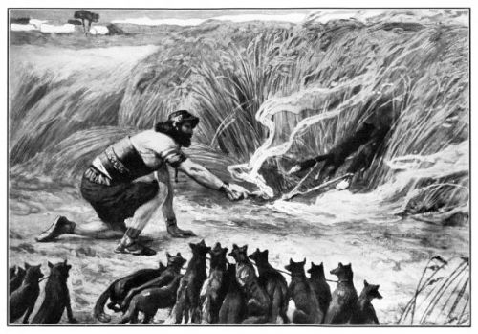
Samson & the Foxes
(Judges 15)
Notes:
Chapter 15 NLT
Samson’s Vengeance on the Philistines
Later on, during the wheat harvest, Samson took a young goat as a present to his wife. He said, “I’m going into my wife’s room to sleep with her,” but her father wouldn’t let him in.
2 “I truly thought you must hate her,” her father explained, “so I gave her in marriage to your best man. But look, her younger sister is even more beautiful than she is. Marry her instead.”
3 Samson said, “This time I cannot be blamed for everything I am going to do to you Philistines.” 4 Then he went out and caught 300 foxes. He tied their tails together in pairs, and he fastened a torch to each pair of tails. 5 Then he lit the torches and let the foxes run through the grain fields of the Philistines. He burned all their grain to the ground, including the sheaves and the uncut grain. He also destroyed their vineyards and olive groves.
6 “Who did this?” the Philistines demanded.
“Samson,” was the reply, “because his father-in-law from Timnah gave Samson’s wife to be married to his best man.” So the Philistines went and got the woman and her father and burned them to death.

Slide 89
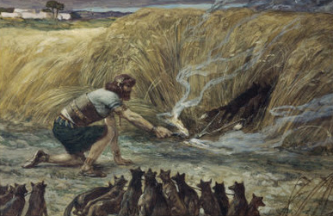
"Samson said, 'This time I cannot be blamed for everything I am going to do to you Philistines.' ⁴Then he went out and caught 300 foxes. He tied their tails together in pairs, and he fastened a torch to each pair of tails. ⁵Then he lit the torches and let the foxes run through the grain fields of the Philistines. He burned all their grain to the ground, including the sheaves and the uncut grain. He also destroyed their vineyards and olive groves"
(Judges 15:3-5 NLT).

Slide 90
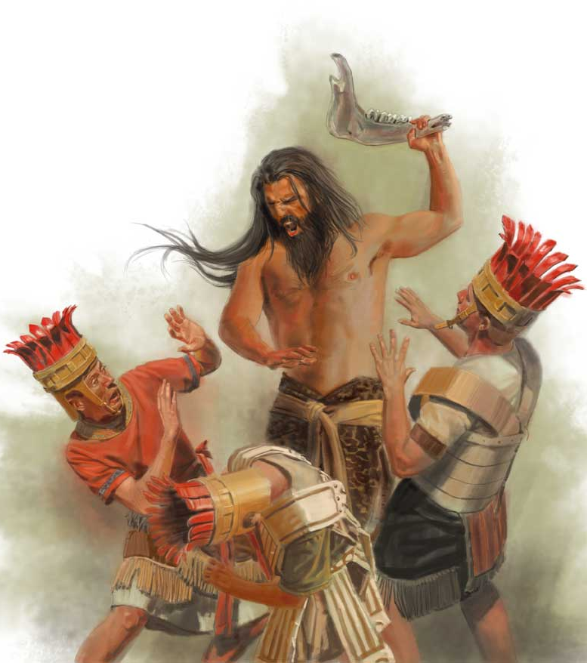
Samson's Jawbone Revenge (15:15-16)

Slide 91
Slides on
Judges 16

Slide 92
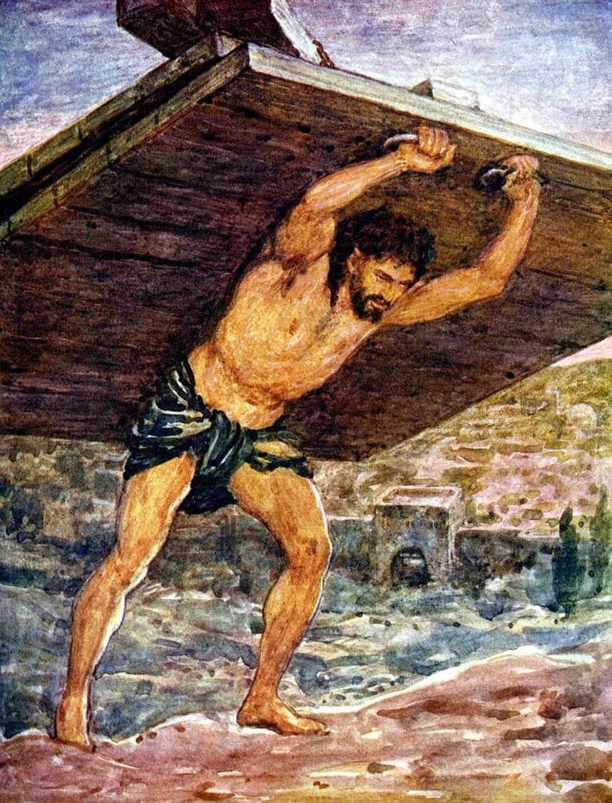
"But Samson stayed in bed only until midnight. Then he got up, took hold of the doors of the town gate, including the two posts, and lifted them up, bar and all. He put them on his shoulders and carried them all the way to the top of the hill across from Hebron"
(Judges 16:3 NLT).

Slide 93
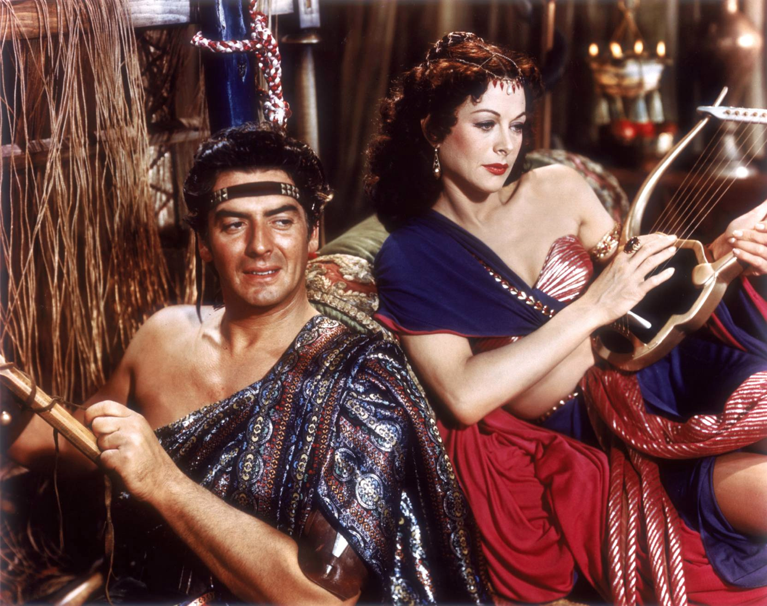
Samson & Delilah

Slide 94
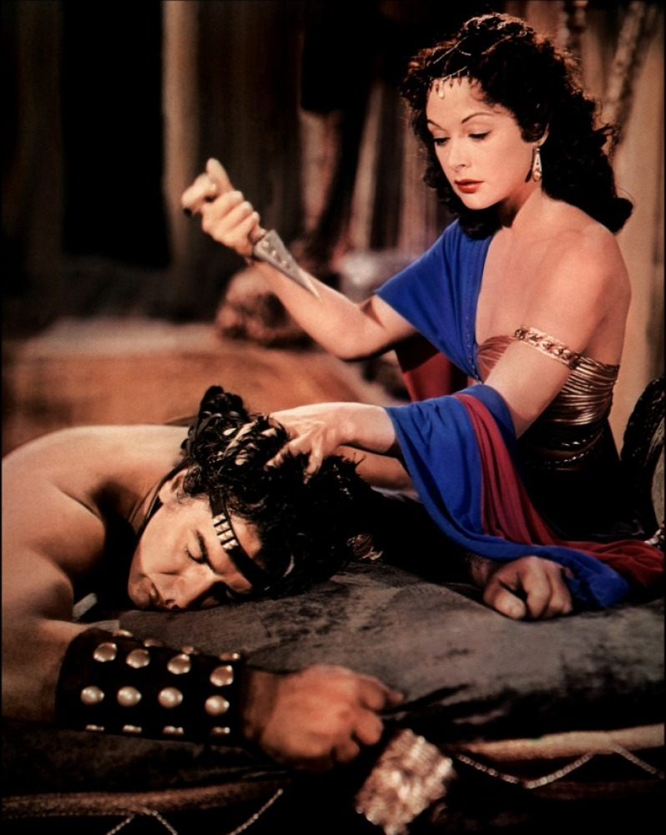
Samson

Slide 95
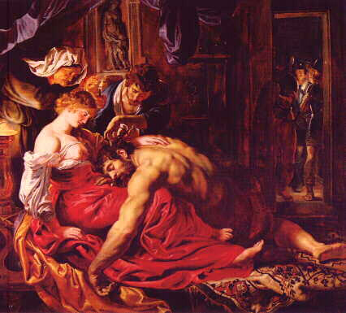
What was his weakness?
The Story of Samson
Her?
Hair?
Heart?
"Samson… the he man with a she weakness"
-Chuck Swindoll

Slide 96
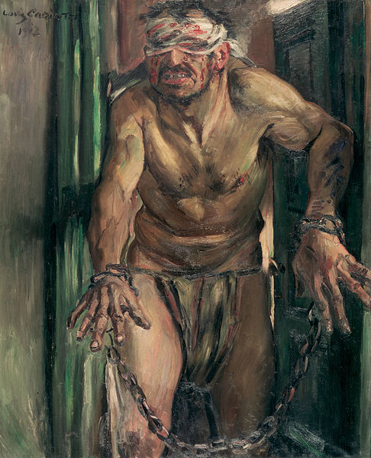
Samson's Haircut

Slide 97
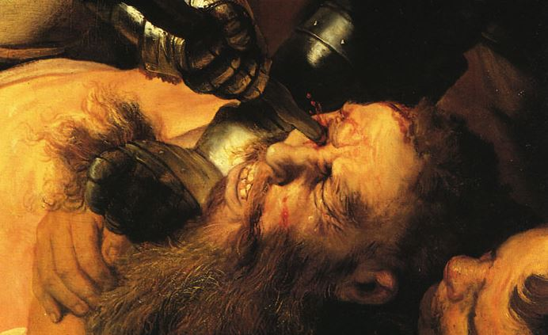
Samson's
Eyes Cut

Slide 98
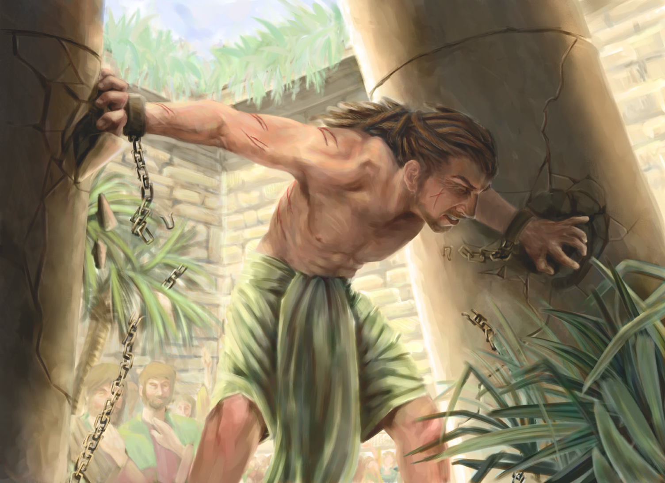
Samson's Death

Slide 99
The Samson Cycle
174
"Samson had judged Israel for twenty years" (16:21) but no mention is made of the nation experiencing peace after Samson's 20-year rule.
1 Sin
2 Servitude
5 Silence
3 Supplication
4 Salvation

Slide 100
We go in circles when we make up the rules.
Notes:
Repeated cycles tell us that the only thing we learn from history is that we don’t learn from history.
Is your commitment to Christ cyclical?
How can you stop the cycles? Go back to the Source daily.

Slide 101

Moral Relativism
Notes:
Repeated cycles tell us that the only thing we learn from history is that we don’t learn from history.

Slide 102

Relativism
Notes:
Is your commitment to Christ cyclical?

Slide 103

Band-Aids on a Gunshot Wound
Lessons from Judges
Notes:
When someone gets a wound from a gun, it is very serious and requires immediate surgery to prevent bleeding and later infection. How silly to simply place a small adhesive strip over it such as a Band-Aid rather than carefully taking the bullet out, but this is candid way that we often view sin today. We have serious problem with sin, but we typically lack a serious solution, thinking that a simple prayer or confession would heal the issue. Of course, this only gives time for an infection to occur, so that a serious problem gets even more problematic. How can you stop the cycles? Go back to the Source daily.

Slide 104
Why must you be steadfast in having God as your king?
3 reasons
Notes:
Today we will see three reasons to place God as king.

Slide 105
I. Incomplete obedience plants the seeds for failure (1–2).
Notes:
Rejecting God’s lordship through disobeying him as king leads to trouble.

Slide 106
II. Relativism leads to cycles of sin (3–16).
Notes:
We go in circles when we follow our rules instead of God’s absolute standards.

Slide 107
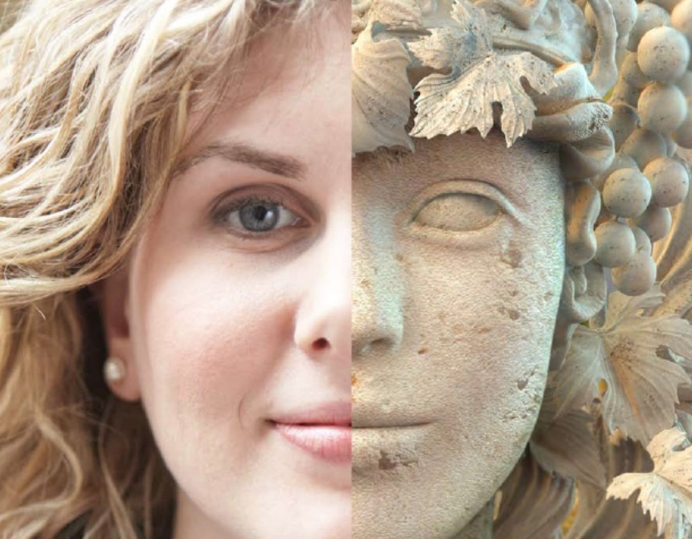
III. Relativism leads to idolatry (17–21).
Notes:
Whims instead of wisdom worships a different god.

Slide 108
Israel's religious and moral failures showed they needed a righteous king instead of their relativism (Judges 17–21).

Slide 109
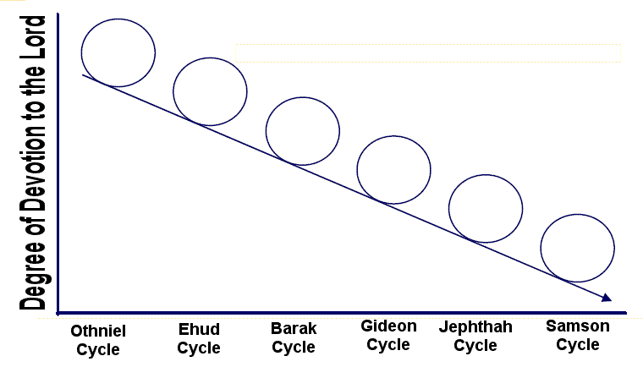
Downward Spiral of the Cycles
Degree of Devotion to the Lord
Othniel
Cycle
Ehud
Cycle
Barak
Cycle
Gideon
Cycle
Jephthah
Cycle
Samson
Cycle

Slide 110
Judges of Israel
174
Peace 5x
Peace 4x
Peace 2x
Peace 6x
Oppression 3x
Oppression 2x

Slide 111
Slides on
Judges 17

Slide 112
Depravity (17–21)
172
Failure Under the Theocracy
Incomplete
Occupation
Need
for Monarchy
Deliverance by Judges
1:1–2:5
2:6–16:31
17–21
Deterioration
Discipline
Depravity
Causes
Of the Cycles
Curse
Of the Cycles
Conditions
Of the Cycles
Living with
the Canaanites
War with
the Canaanites
Living Like
the Canaanites
Military
Disobedience
1
Spiritual
Disobedience
2:1-5
Intro
2:6-3:6
South
3:7-31
East
10:3-
12:7
North
12:8-
12:15
West
13:1-
16:31
Religious
Depravity
17-18
Moral
Depravity
19-21
North
4:1-5:31
Central
6:1-10:2
Canaan
c. 341 Years (1390-1049 BC)

Slide 113
Religious Failure (17–18)
Personal apostasy of Micah (ch. 17)
- Idolatry
- Hiring a Levite pagan priest

Slide 114
Slides on
Judges 18

Slide 115
Religious Failure (17–18)
Personal apostasy of Micah (ch. 17)
- Idolatry
- Hiring a Levite pagan priest
Tribal apostasy (ch. 18)
- Levite blesses the selfish, faithless migration plan of the Danites
- Syncretism

Slide 116
Cause & Effect
Religious Failure
Moral Failure

Slide 117
Slides on
Judges 19

Slide 118

Moral Failure (19–21)
Benjamites in Gibeah rape and kill a Levite's concubine

Slide 119


**** Gibeah Gazette ****
THE MOST OUTRAGEOUS STORY IN THE BIBLE
CONCUBINE KILLED & CUT INTO 12 PIECES (JUDG. 19:1-30)
"Now in those days Israel had no king. There was a man from the tribe of Levi living in a remote area of the hill country of Ephraim. One day he brought home a woman from Bethlehem in Judah to be his concubine."
JUDGES: UNFAITHFUL PEOPLE… FAITHFUL GOD

Slide 120
Moral Failure (19–21)
Benjamites in Gibeah rape and kill a Levite's concubine (19)

Slide 121
Slides on
Judges 20

Slide 122
Moral Failure (19–21)
Benjamites in Gibeah rape and kill a Levite's concubine (19)
- 400,000 warriors of other 11 tribes destroy 26,100 Benjamites, including women and children (20).

Slide 123
Near Destruction of the Tribe of Benjamin
171
Asher
53,400
Naphtali
45,400
Judges 20
Zebulun
60,500
Manasseh
Issachar
64,300
Manasseh
52,700
Levi
23,000
Spread Throughout Israel
Gad
40,500
Ephraim
32,500
Dan
64,400
Benjamin
45,600
Reuben
43,730
Judah
76,500
Simeon
22,200
Numbers 26 Populations

Slide 124
Slides on
Judges 21

Slide 125
Moral Failure (19–21)
Benjamites in Gibeah rape and kill a Levite's concubine (19)
- 400,000 warriors of other 11 tribes destroy 26,100 Benjamites, including women and children (20).
- Benjamites kill everyone in Jabesh Gilead except 400 virgins and steal another 200 virgins at Shiloh as wives for the remaining 600 Benjamites to preserve their line.

Slide 126

The Last Verse is the Key Verse
"In those days Israel had no king. Everyone did as he saw fit"
(Judges 21:25).

Slide 127
Be guided by wisdom instead of whims that worship a different god.
Notes:
Replacing God’s wisdom with personal whims is idolatry.
There exist several reasons idols appeal to people.
Jesus said that no one could serve two masters.

Slide 128
Apostasy's Bitter Fruits
political disintegration
tribal hostility
social chaos
increased immorality
disregard of the law
anarchy

Slide 129

Defining Idolatry
IDOLATRY
MAKING A GOOD THING THE ULTIMATE THING.
Notes:
Replacing God’s wisdom with personal whims is idolatry. That means “making a good thing the ultimate thing.”

Slide 130

Defining Idolatry
Notes:
It applies, for example, to making sex the most important thing in your life.

Slide 131

Defining Idolatry
Notes:
Interestingly, that can even apply to marriage. Jesus said that no one could serve two masters—God and money—but he also said that we need to love him even more than our spouse!

Slide 132
Why must you be steadfast in having God as your king?
Notes:
Today we will see three reasons to place God as king.

Slide 133

Main Idea
Make God king
—not relativism and the idolatry of sin cycles
Judges
Notes:
Be steadfast with God as king so you don’t have to fail over and over (restatement).

Slide 134
I. Incomplete obedience plants the seeds for failure (1–2).
Notes:
Rejecting God’s lordship through disobeying him as king leads to trouble.

Slide 135
II. Relativism leads to cycles of sin (3–16).
Notes:
We go in circles when we follow our rules instead of God’s absolute standards.

Slide 136
III. Relativism leads to idolatry (17–21).
Notes:
Whims instead of wisdom worships a different god.

Slide 137

Discussion Question:
How is Our Day Like the Judges Period?
Relativism: "Save the whales" but kill humans
Secularism: "I don't let my religion affect my politics"
Promiscuity: "What that leader does in his bedroom is his business and not mine"

Slide 138

Relativism
This pamphlet is blank.
We're atheists.
Notes:
Relativism is seen in atheism where anything can be written on their pamphlets.

Slide 139

Applications
172
Rejecting God's lordship (incomplete obedience) plants the seeds for failure (1–2).
Personal relative standards instead of God's absolute standards lead to cycles of sin (3–16).
Replacing God's wisdom with personal whims leads to idolatry (17–21).

Slide 140

Be Steadfast.

Slide 141

Think about it.
Who is the real boss of your life?
How can you enthrone God as your true king?

Slide 142

Therefore, my beloved brothers,
be steadfast,
immovable,
always abounding in the work of the Lord,
knowing that in the Lord your labour is not in vain.
1 Corinthians 15:58

Slide 143
Black

Slide 144


OT Preaching link at BibleStudyDownloads.org
Get this presentation and script for free!

